Slide 1
QUANTITATIVE INVESTING · SPRING 2026
5 Factor Equity Strategy
Momentum Value Profitability Low Volatility
Drew Galvin

Slide 2
The Investment Thesis
THE IDEA:
Stocks that are simultaneously winning, cheap, profitable, and less volatile should outperform the market over time because they combine multiple persistent return drivers in one disciplined portfolio.
↑
↗
💲
★
⊗
Mid-Term
Momentum
Short-Term
Momentum
Value
Profitability
Low Volatility
ret_12_1
ret_6_1
be_me
qmj_prof
rvol_21d
WHY THESE FIVE?
Mid-Term Momentum (ret_12_1): if a stock has been on a roll for the past year, it tends to keep going — one of the most well-studied patterns in all of finance
Short-Term Momentum (ret_6_1): same idea over a shorter 1–6 month window — picks up a slightly different signal, so using both gives us more edge than either alone
Value (be_me): book-to-market ratio flags stocks the market has written off but whose fundamentals say otherwise — buying cheap has rewarded patient investors for decades
Profitability (qmj_prof): a quality score that asks: is this company actually making good money? High scorers tend to keep outperforming even when other factors stumble
Low Volatility (rvol_21d): how much has this stock been bouncing around lately? We dial down exposure to the most erratic names — smoother ride, better risk-adjusted returns
2 / 10

Slide 3
Portfolio Construction
01
Stock Pool
04
Select
Start with stocks above the bottom 20% of market cap, so we filter out the tiny, less liquid names
Pick the top 100 stocks by composite score
02
Score
05
Weight
Percentile-rank each stock (0→1) on all 5 factors each month
Equal-weight at 1% each — isolates pure factor signal
03
Composite
06
Rebalance
Simple average of the 5 ranks, each variable has a weight of 20% — no optimization, no fitted weights which helps reduce overfitting risk.
Quarterly (Mar/Jun/Sep/Dec) with a 40-stock retention buffer to limit turnover
Signals are measured using information available at month-end, used to predict next month’s excess return; stocks missing any of the five signals are excluded; quarterly rebalancing and a retention buffer are used to reduce turnover.
3 / 10

Slide 4
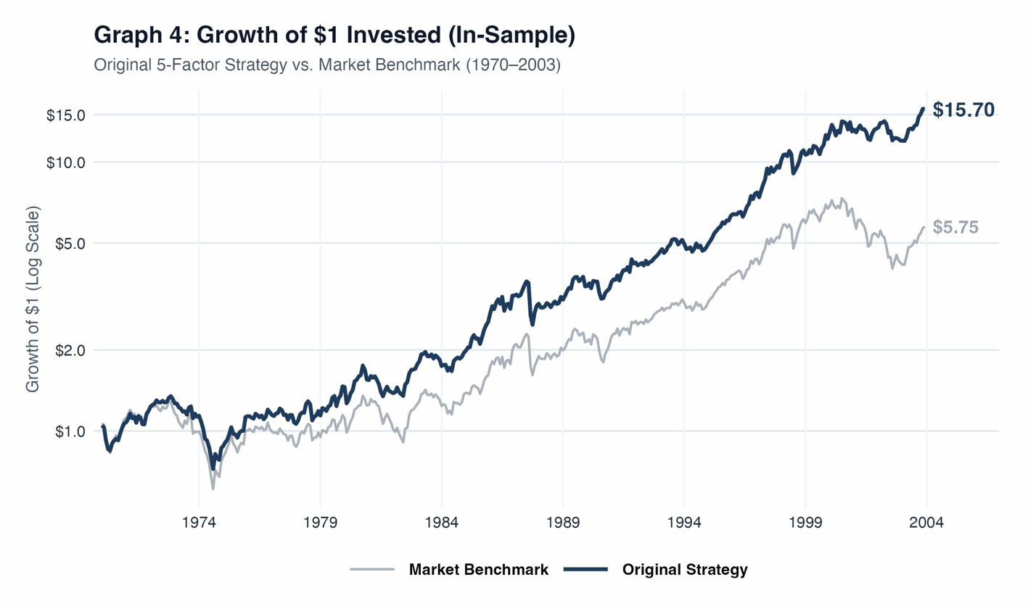
In-Sample Performance · 1970–2003
Metric
Strategy
Market
Avg. Annual Return
9.71%
6.75%
Annual Std. Dev.
15.31%
16.63%
Sharpe Ratio
0.63
0.41
CAPM Alpha (mo.)
−0.174
—
CAPM Beta
0.865
1.00
The strategy earned +296 basis points of annualized excess return with LOWER volatility than the market. $1 grew to $15.70 vs. the market's $5.75 — nearly 3×.
4 / 10

Slide 5
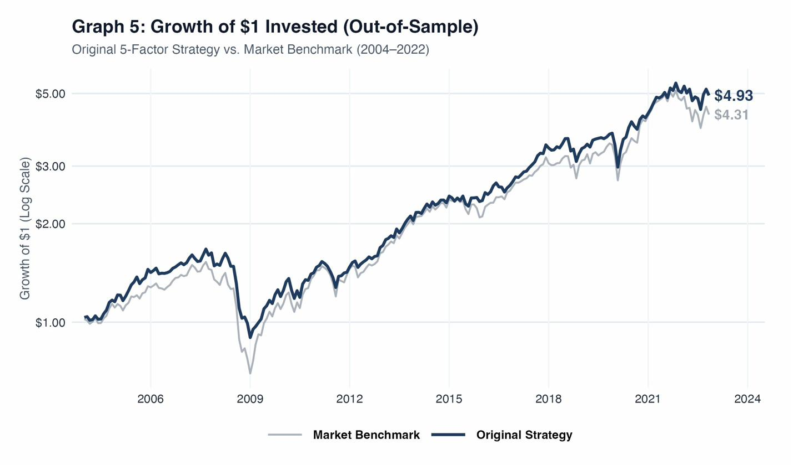
The Real Test: Out-of-Sample · 2004–2022
Metric
Strategy
Market
Avg. Annual Return
9.88%
9.44%
Annual Std. Dev.
14.08%
16.05%
Sharpe Ratio
0.70
0.59
CAPM Alpha (mo.)
+0.094
—
CAPM Beta
0.835
1.00
On 18 years of data the strategy had NEVER seen, the Sharpe ratio IMPROVED from 0.63 → 0.70. Volatility fell. $1 → $4.93 vs. market's $4.31. The bet held.
5 / 10

Slide 6
Out-of-Sample Factor Significance · Fama-French 6-Factor Regression
Factor | Alpha (α) | Market β (MktRF) | Size β (SMB) | Value β (HML) | Profit. β (RMW) | Invest. β (CMA) | Momentum β (UMD)
Coefficient | −0.069 | 0.930 | 0.009 | 0.109 | 0.145 | 0.022 | 0.278
t-stat | −0.79 | 42.69 | 0.22 | 2.92 | 2.96 | 0.37 | 12.50
Significant? | ❌ | ✅ | ❌ | ✅ | ✅ | ❌ | ✅
Meaning? | – | Less risky than market; highly market-driven | – | Favor cheaper / value stocks | Favor higher profitability / quality | – | Favor recent winners / momentum
★ Significance based on p < 0.05 using out-of-sample Fama-French 6-factor regression p-values.
Key Takeaway: Out-of-sample performance was not driven by significant alpha. It was primarily explained by significant exposure to Market, Value, Profitability, and Momentum factors.
6 / 10

Slide 7
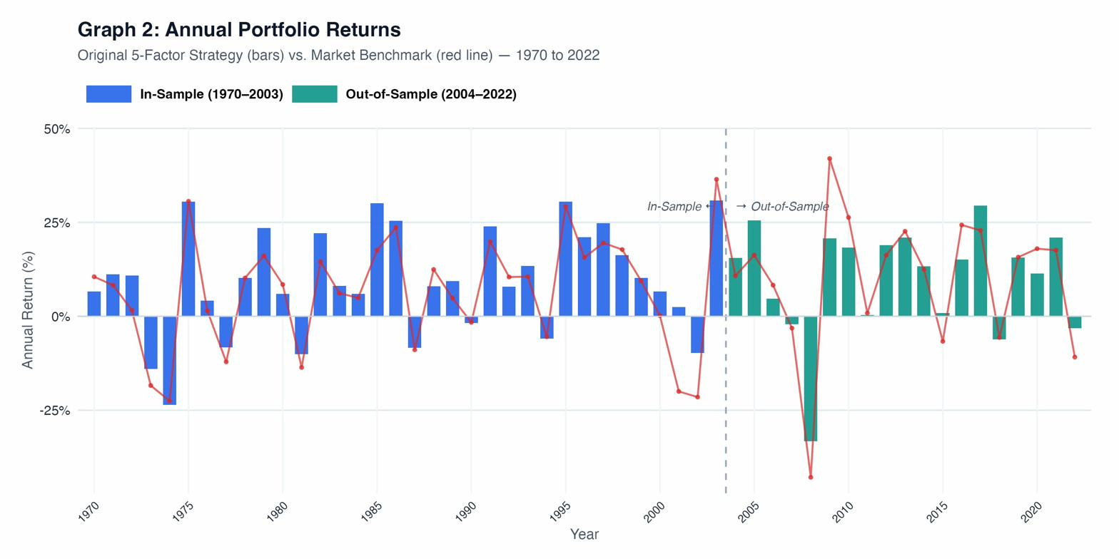
Annual Portfolio Returns · 1970–2022
53 years of annual performance. Blue = In-Sample · Teal = Out-of-Sample · Red line = Market. In most years our bars sit above the red line — and in bad years we typically lose less.
7 / 10
7 / 10

Slide 8
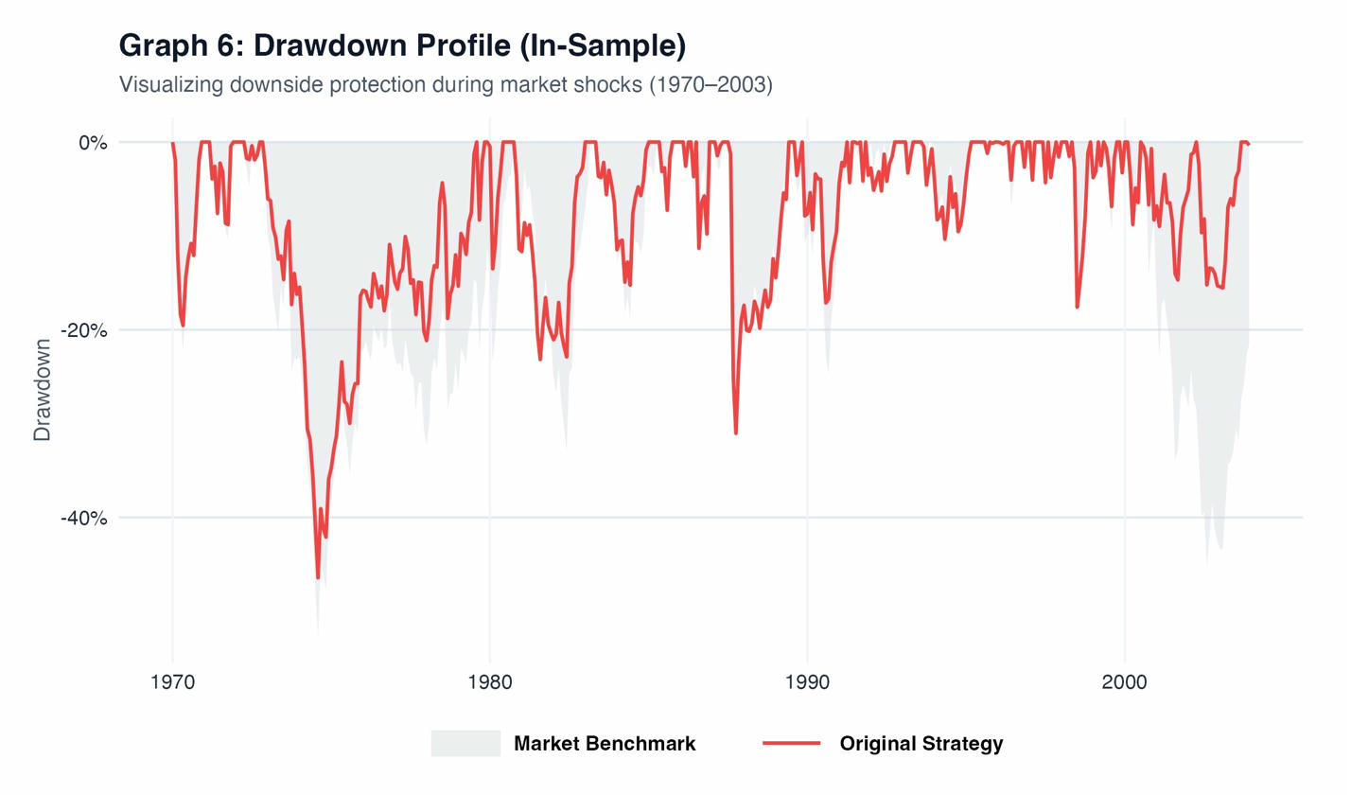
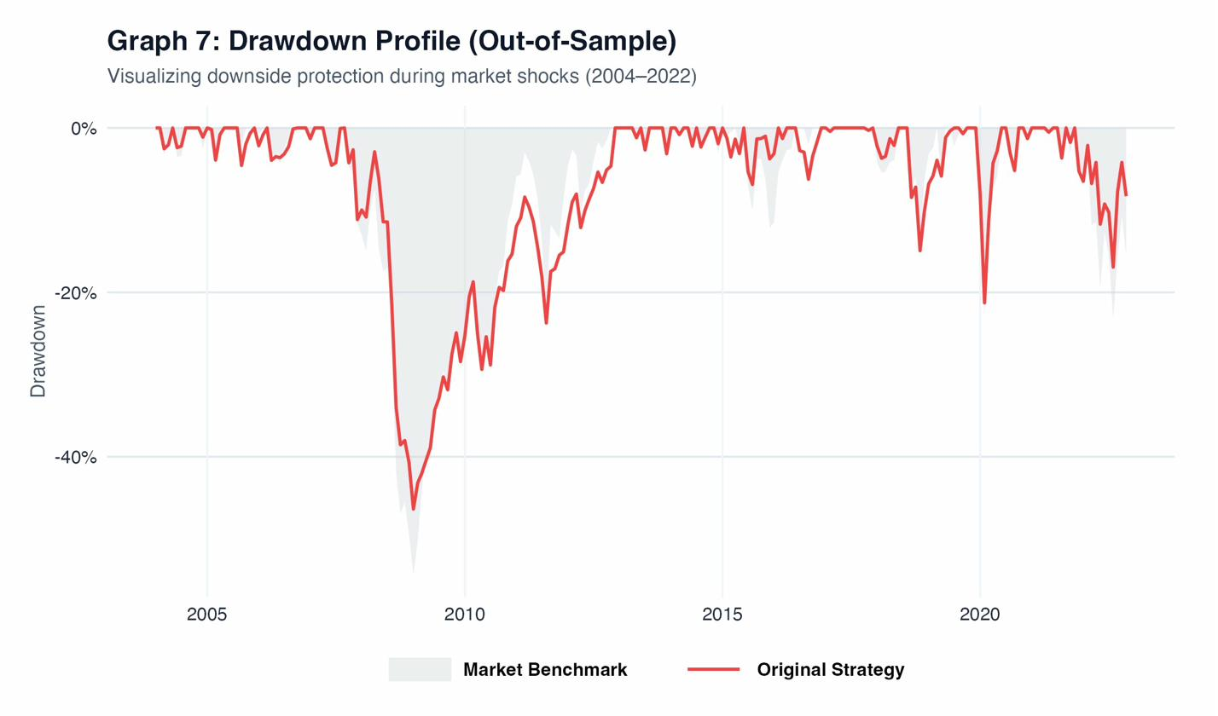
Drawdown Protection · When Markets Crash
In-Sample (1970–2003)
Out-of-Sample (2004–2022)
Gray area = market drawdown. Red line = strategy. In 2008 the market fell over 50% — our strategy fell less and recovered faster. The low-volatility factor doing its job in real crises.
8 / 10

Slide 9
Lessons Learned · What Worked and What Didn't in Future Data
✓ WHAT WORKED
⚠ WHAT STRUGGLED
Momentum stayed strong
Value weakened significantly
UMD loading barely changed: 0.274 IS → 0.278 OOS. The signal was just as powerful on unseen data.
HML loading dropped from 0.230 → 0.109. The well-documented 'death of value' in the 2010s growth cycle.
Profitability got stronger
Excess return margin narrowed
RMW loading increased from 0.116 → 0.145. Quality companies kept delivering.
IS had +296 bps excess return. OOS had only +44 bps. The edge compressed substantially.
Low volatility protected capital
FF6 Alpha remains near zero
Consistent downside protection through 2008, COVID, and every correction in between.
Returns are explained by factor exposure, not 'true' alpha. Expected for a factor-harvesting strategy.
Sharpe ratio improved
Investment (CMA) signal faded
0.63 in-sample → 0.70 out-of-sample. Risk-adjusted efficiency actually got better.
Loading nearly vanished: 0.073 → 0.022. The conservative investment signal did not persist.
9 / 10

Slide 10
Conclusion
0.70
9.88%
14.08%
$77.49
OOS Sharpe
(vs. 0.63 IS)
OOS Annual
Return
OOS Volatility
(mkt: 16.05%)
Full 53yr
Terminal Wealth if $1 was invested
✓
The thesis was validated — a simple, non-optimized 5-factor composite beat the market on 18 years of unseen data.
↑
Risk-adjusted performance improved out-of-sample. Sharpe 0.63 → 0.70. This is the opposite of what you'd expect from overfitting.
⊙
The strategy is investable — no leverage, no shorting, quarterly rebalancing, liquid large/mid-cap universe.
!
Honest limitations: value exposure weakened, excess returns narrowed. This is a factor-harvesting strategy, not an alpha machine.
→
→
Next time: tilt harder toward momentum & quality (value faded over time), switch to monthly rebalancing to better capture short-term momentum decay, and model transaction costs to keep turnover realistic.
By combining five independent, academically-grounded factor signals into a simple rules-based portfolio, we built a strategy that delivered higher returns with lower risk — and that result held on data the model had never seen.
10 / 10

